Slide 1
IT1102
Computer Hardware
Week 3
Internal Structure and File System of a Hard disk

Slide 2
Hard disk
Non Volatile
Mutable
Secondary / auxiliary

Slide 3
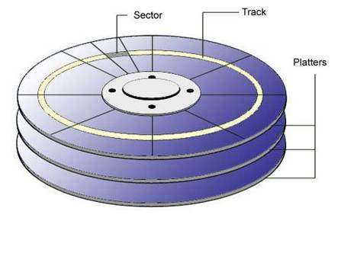
Internal Structure of a Hard Disk
Stack of circular metal platters
Coated with magnetic material

Slide 4
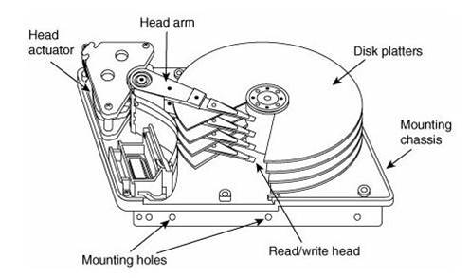
Platters rotate at speed
  eg: 7200 rpm
Electromagnetic read/write heads read and write data

Slide 5
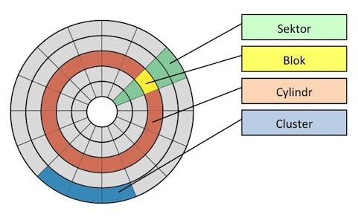
Internal Structure of a Hard Disk

Slide 6
File System
Database to store data about files in a disk
  File name
  Location / address
File allocation Table maintain the physical location of the files
Displayed in a hierarchy

Slide 7
File Systems
  FAT 16
    DOS and Windows 3.x
    Originally designed for use on small partitions up to 4GB
    File names are limited to 8 characters
  FAT 32
    Introduced with Win98
    No limitations for file name length
    Support drives up to 2 TB
    Weak in error recovery
    No built-in file security

Slide 8
File Systems
NTFS
  Introduced with Windows NT
  Secure and robust than FAT16 or FAT32
      Permission control
      Encryption
      Compression
  Offers better recovery from errors
  Support extremely large storage media
  Capable of long file names

Slide 9
File Systems
NFS
  Distributed file system or Network File System
  Multiple users on multiple machines to share files
CDFS
  Compact Disk filing system
  Used with Linux
Hierarchical File System (HFS)
  Developed by Apple Inc. for Mac OS
HFS Plus
  Apple Inc. to replace Hierarchical File System (HFS)
  Used in Macintosh
UNIX file system (UFS)
  Unix and Unix-like operating systems

Slide 10
File Systems
Operating System | File System
Windows 2000/XP/ Server 2003 | FAT12, FAT16, FAT32 & NTFS
Windows NT 4.0 | FAT12, FAT16, & NTFS
Windows 95 SR2/98/ 98SE/Me | FAT12, FAT16 and FAT32
Windows 95 | FAT12 & FAT16

Slide 11
Formatting
Preparing a storage device for initial use
Formatting process include three steps
  Low-level formatting
  Partitioning
  High-level formatting

Slide 12
Low Level Formatting
Basic storage device preparation for data storing
Lays the permanent foundation of the disk
Completed at the factory by manufactures
Create tracks and sectors

Slide 13
Disk Partitioning
Creation of one or more regions on a hard disk or other secondary storage
Operating system can manage information in each region separately.

Slide 14
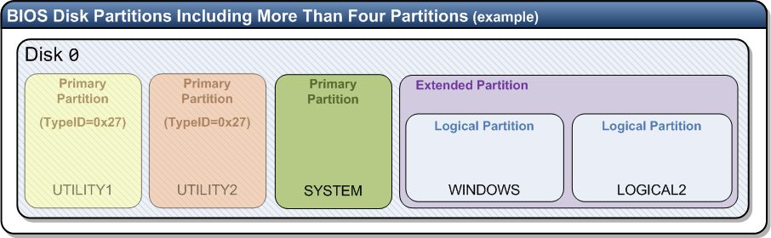
Disk Partitioning
Partition - Also called a volume
An area on a hard disk that can be formatted with a file system and identified with a letter of the alphabet

Slide 15
Disk Partitioning
In Windows 7, the first three partitions you create are primary partitions
  Primary partitions can be used to start an operating system
If you want to create more than three partitions, the fourth partition is created as an extended partition
Logical partitions or logical drives
  Created in extended partition
  Function like primary partitions except that they cannot be used to start an operating system

Slide 16
Create New Partition on a Windows 7
Hard Disk
Use Windows 7 Disk Management tool
Typing diskmgmt.msc at search or run
Control Panel, Administrative Tools, Computer Management, Disk Management

Slide 17
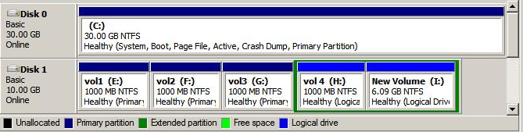
Types of Windows 7 Partitions

Slide 18
High Level Formatting
Setting up an empty file allocation table
  FAT,NTFS,CDFS
Done by system administrators
Before OS installation
Performs on logical drive
Specify cluster size
Useful In a virus infection

Slide 19
High Level Formatting
Data on disk are not fully destroyed during high-level formatting
Instead of an empty file system is stored
Area on the disk containing the data is marked as available
Some old data may be overwritten by new data and File Allocation Table
But most of them may be able to recover by recovery tools.

Slide 20
Class Room Activities
Discuss the defenses between low level formatting and high level formatting
Discuss the defenses between FAT32 and NTFS file systems

